Slide 1


Define Partiicipants
Define Access
Create Participant
Create Identity
Test Access
Deploy in Playground

Slide 2
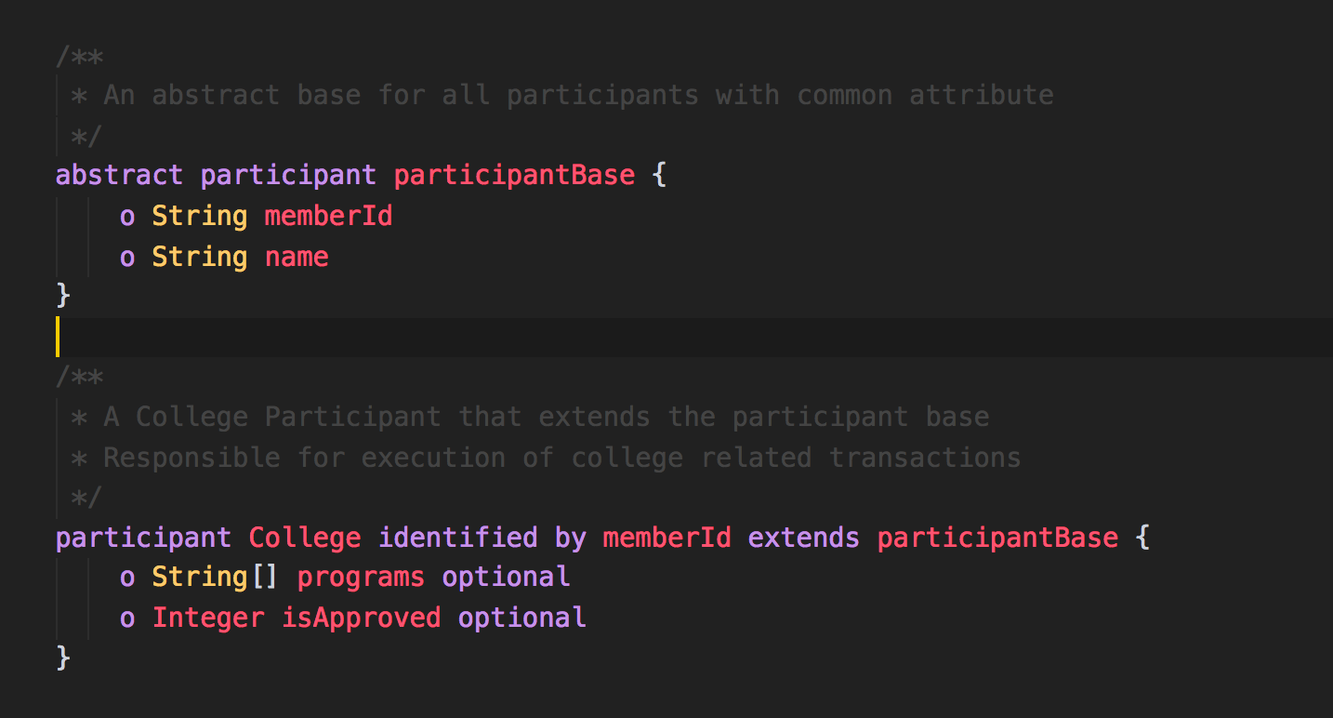
Abstract base for all Participants
Define a College Participant
Few attributes are optional when created and will be added later

Slide 3
Define a College Participant
Few attributes are optional when created and will be added later

Slide 4
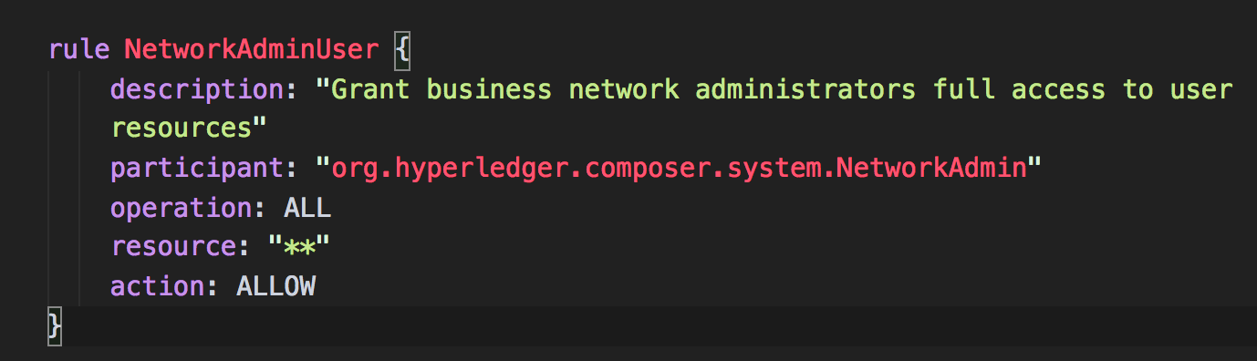
Name of the Rule
Rule is for Whom?
What CRUD operation is allowed
Allow or Deny
On what resources
** means recursive

Slide 5
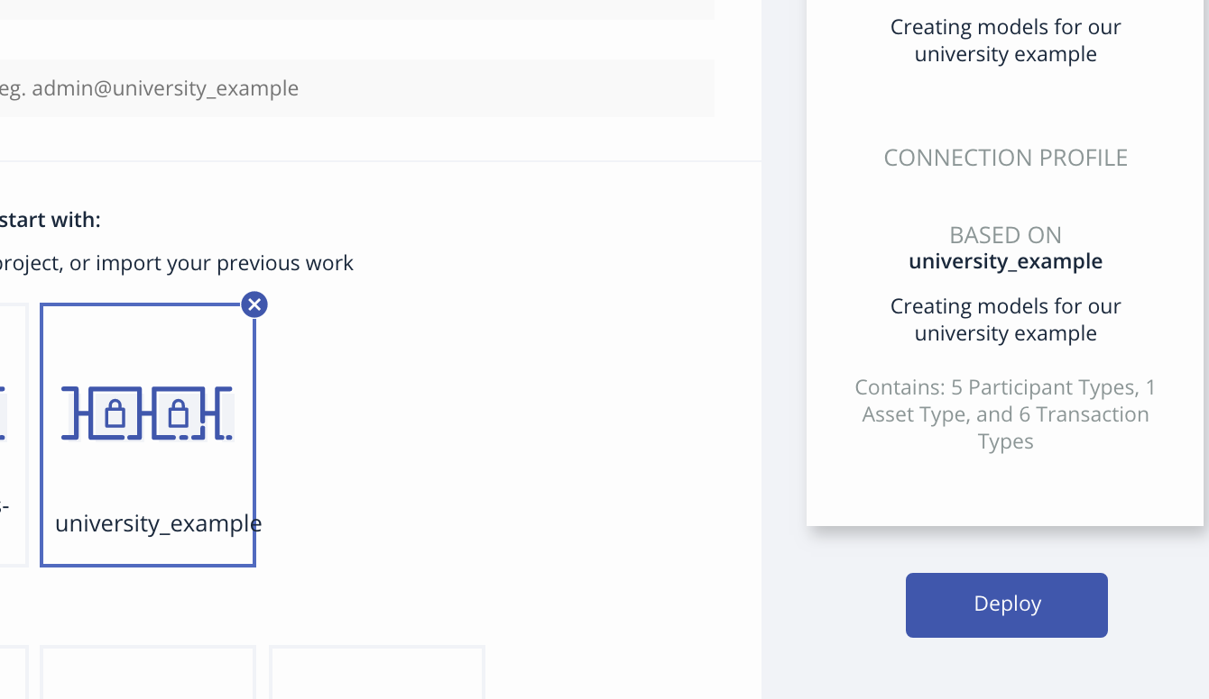

Slide 6
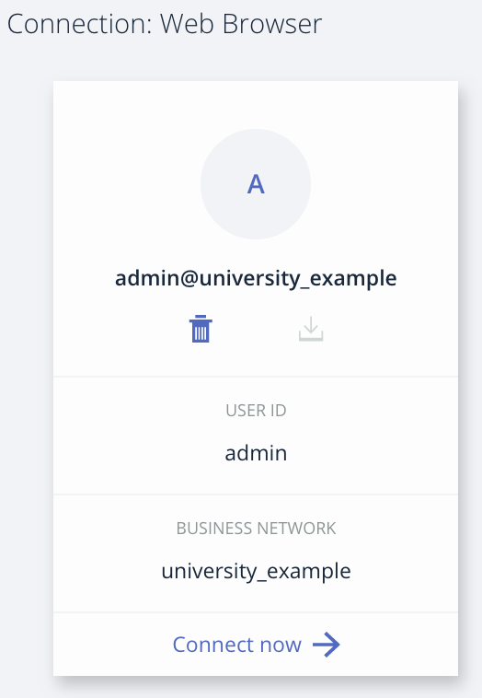

Slide 7
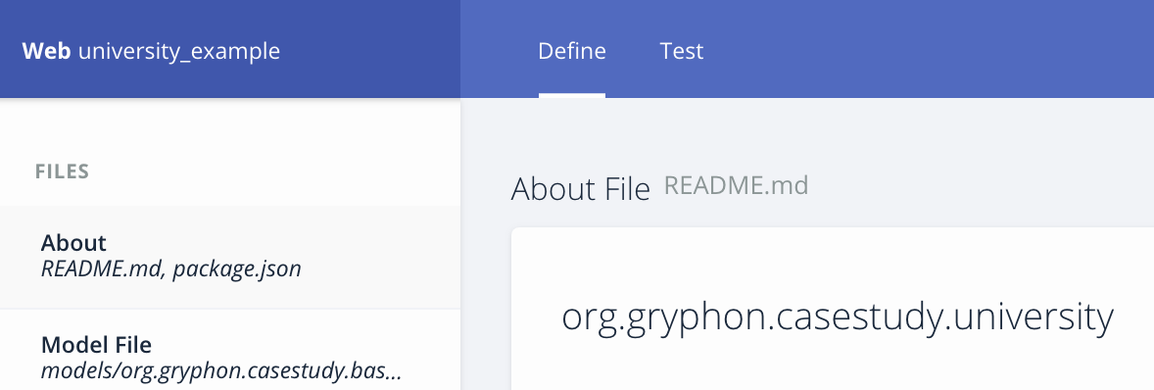

Slide 8
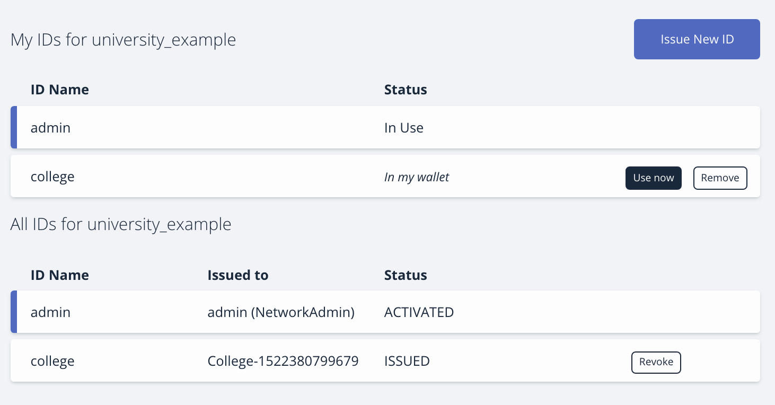
Start Using this ID or Remove it
In Playground, Identities are stored in wallet
Identity is associated to specific Participant
Revoke Access to this Identity

Slide 9
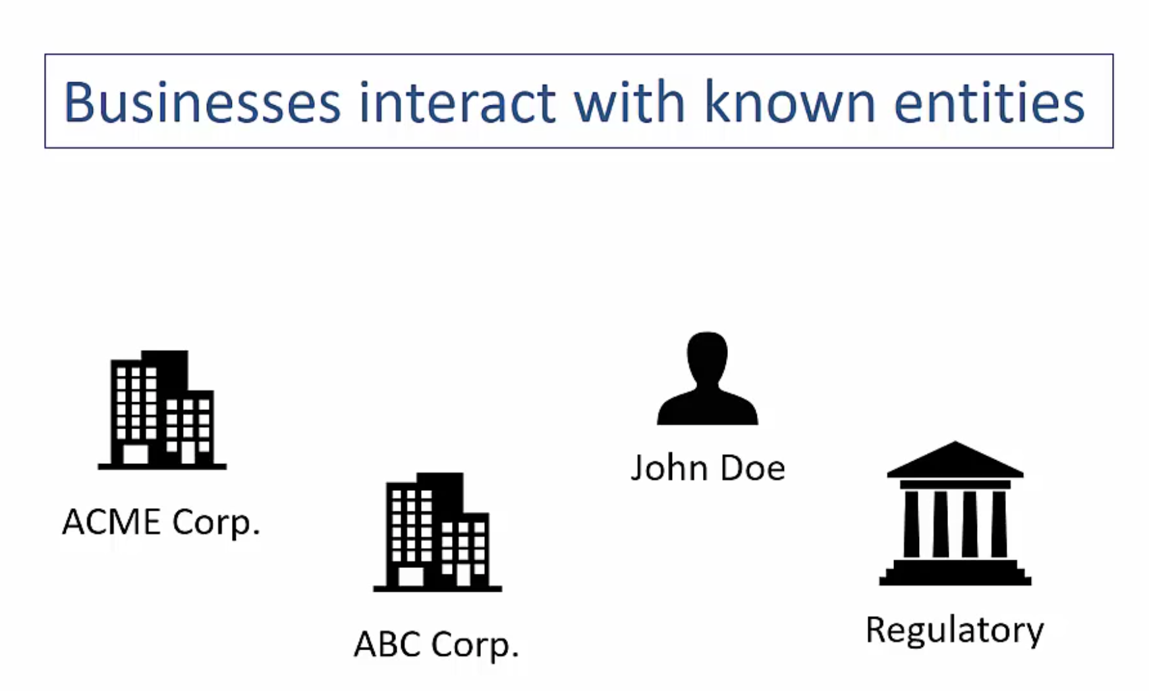
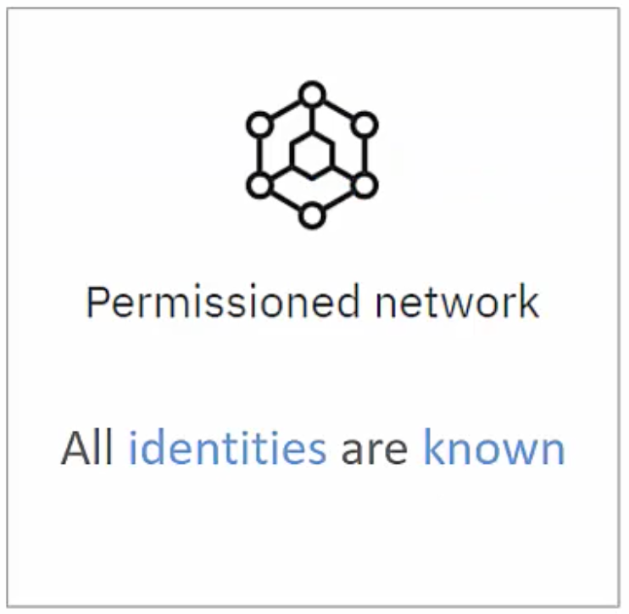


Slide 10
